Slide 1










The role of future leaders in research culture change
Dr Katie Nicoll Baines
People, Culture & Environment Manager
Future Leaders Fellows Development Network
Notes:
Our team comprises core partners from nine industrial and higher education institutions (University of Edinburgh, Cardiff University, Queen’s University Belfast, University of Leeds, School of Advanced Study University of London, Vertical Future, University of Cambridge, University of Glasgow, University College London) as well as additional external partners who support the delivery of our network activities.

Slide 2
What is a Future Leaders Fellow?
FLF programme originated in 2018 to catalyse new forms of research and innovation
Competitive grant process has resulted in just over 600 Fellows in R1-8, with R9 currently being recruited
Grants (usually between £1M and £1.5M) awarded to early career researchers and innovators
Strong indicator that UKRI is using this programme to model (and impact) research culture
No or little teaching requirements, strict guidelines on other commitments
4 year grants + possible 3 year renewal

Slide 3
FLF Development Network Structure
UKRI-funded, UK-wide programme providing leadership development opportunities to FLFs
Our core team is made up of 8 Industrial and HEI partners, with additional external partnerships
Current operating budget is ~£8M running until Jan 2029
Bespoke programme designed specifically for FLFs – nothing is ‘off the shelf’
Responsive programming overlays our annual calendar of events
Notes:
The Future Leaders Fellows Development Network is a UK-wide programme providing leadership and career development opportunities to Future Leaders Fellows (FLFs) and UKRI-nominated Early Career Researchers.
We were first awarded funding from UKRI in October 2020 to support FLF cohorts 1-3, and in January 2022 our second contract was awarded to support cohorts 4-6 with follow-on funding for round 7 and 8 too.

Slide 4
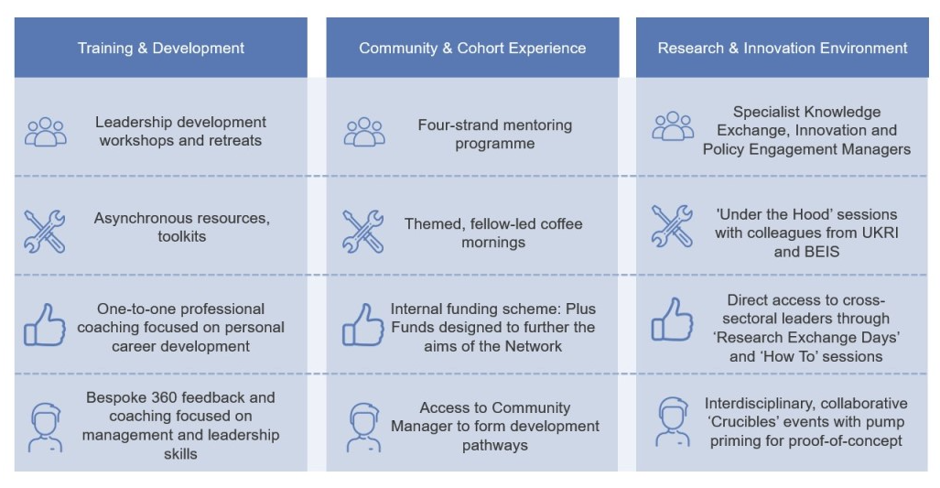
Future Leaders Fellows Development Network
Notes:
We recognise that Future Leaders Fellows are at the forefront of culture change within the research and innovation sectors. Our Network brings these future leaders together, forming cohorts by year group, region, discipline, interest and career ambition.
We currently host over 500 Future Leaders Fellows and Early Career Researchers, supporting their development as leaders both within their teams, institutions and sectors through the delivery of training, community networking and expanding their understanding of the wider research environment.
Our Network activities comprise three fellow-facing areas:

Slide 5
Dr Katie Nicoll Baines, PCE Manager
Specialist on a range of matters relating to research & innovation culture, including equality, diversity and inclusion (EDI), research integrity and sustainability.
Experienced facilitator/trainer with expertise in researching barriers to career progression experienced by women and LGBT+ people related to grant funding.
Leads on developing the legacy of the network in the sector, supporting the evaluation of our activity and disseminating our resources and expertise.
Responsible for the networks EDI strategy and for embedding principles of equality, diversity and inclusion across all network programmes and activities.
Supports our training and development team to embed EDI in the leadership training for fellows and develops bespoke training to respond to specific EDI needs within the Network.
Works with UKRI on strategies to support Inclusive Research Design and provides 1-1 support for research leaders facing their own challenges related to research culture change.

Slide 6
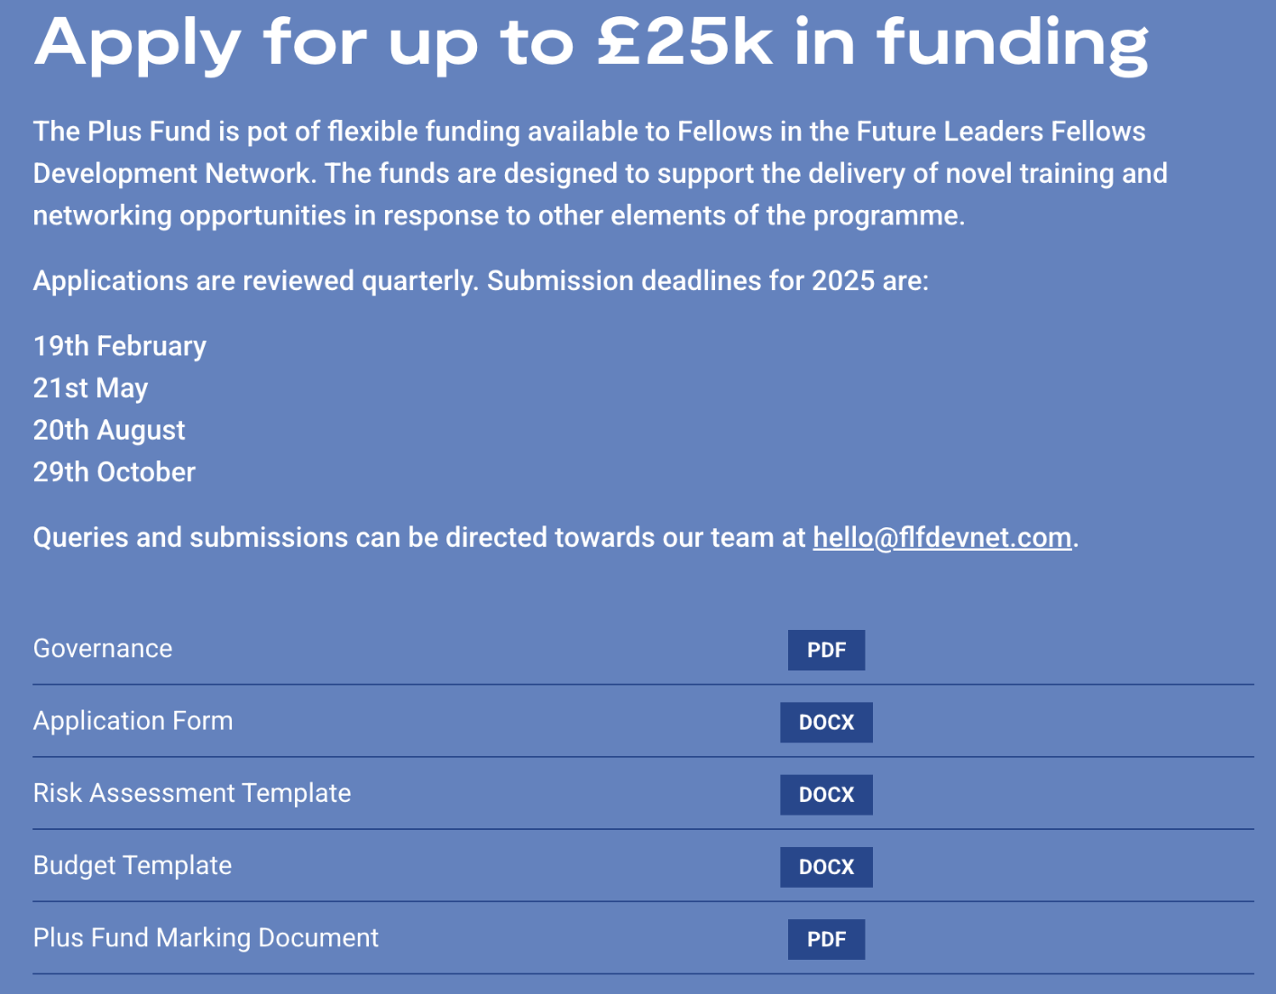
Funding support: Plus Funds
Culturally sensitive mentoring workshop
Designing inclusive team cultures
Researcher Wellbeing
Supporting career development of ECRs
Research insights podcast series
Understanding experiences of FLF carers
LGBTQ+ mentoring & community building

Slide 7
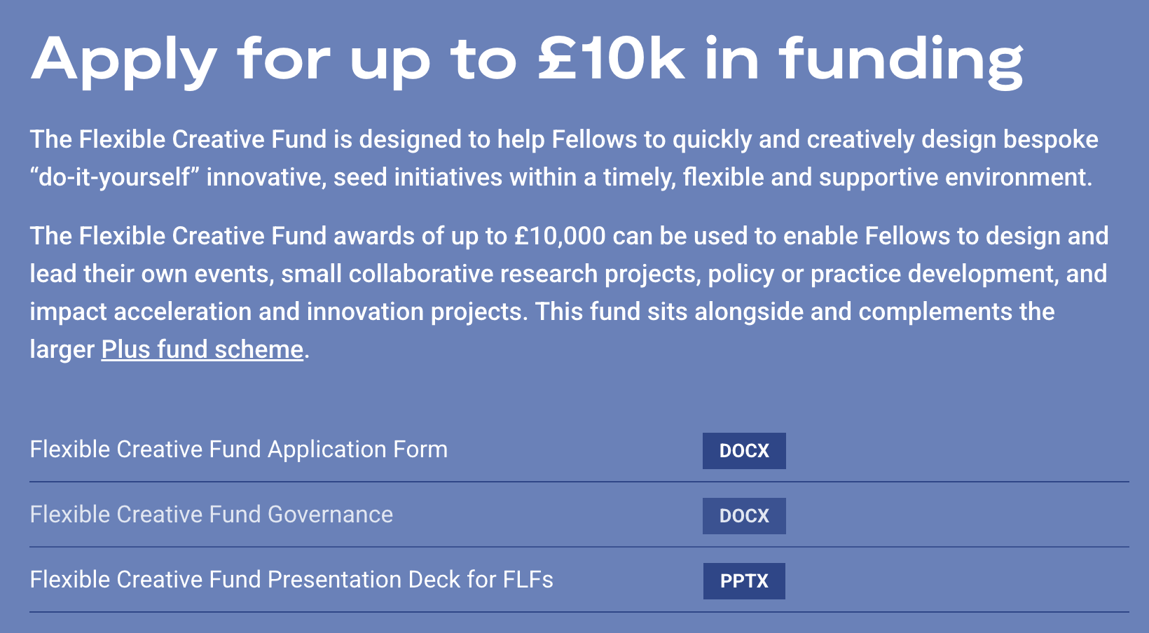
Funding support: Flexible creative fund
Global library project
Participatory research project
Algorithm Pattern Club
Piloting a deliberation approach to support decision makers to respond to ‘wicked problems’
Illustrating & narrating anomalies
Sussex cancer research inaugural event

Slide 8

Funding support: communities of practice

Slide 9


Toolkits

Slide 10


Toolkits

Slide 11
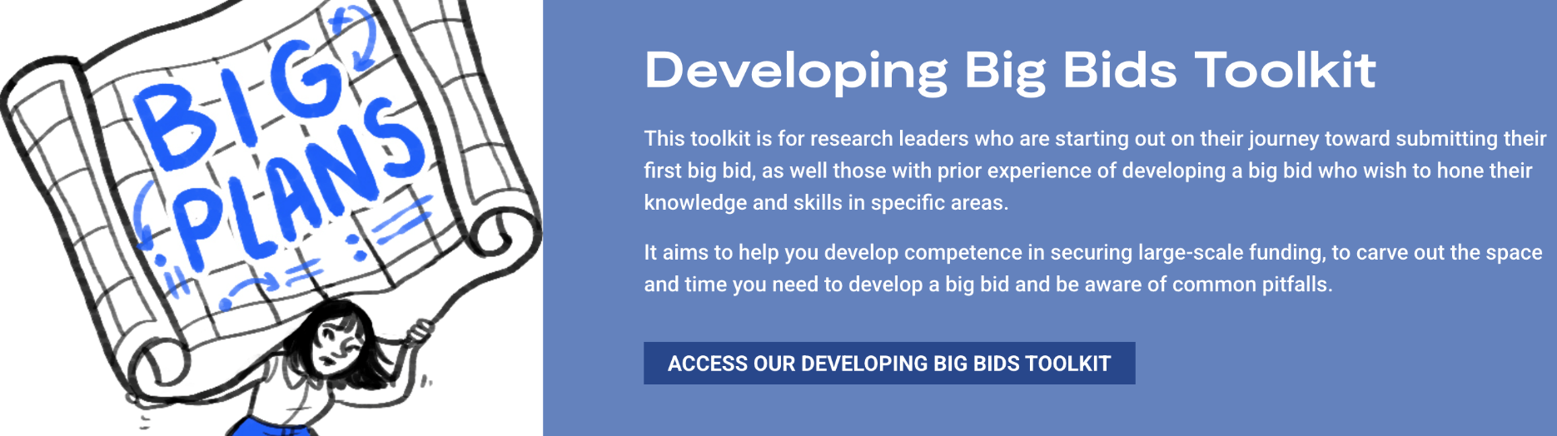

Toolkits

Slide 12
Toolkits
Pending completion:
Policy
Managing inclusive teams
Promoting open research practices

Slide 13
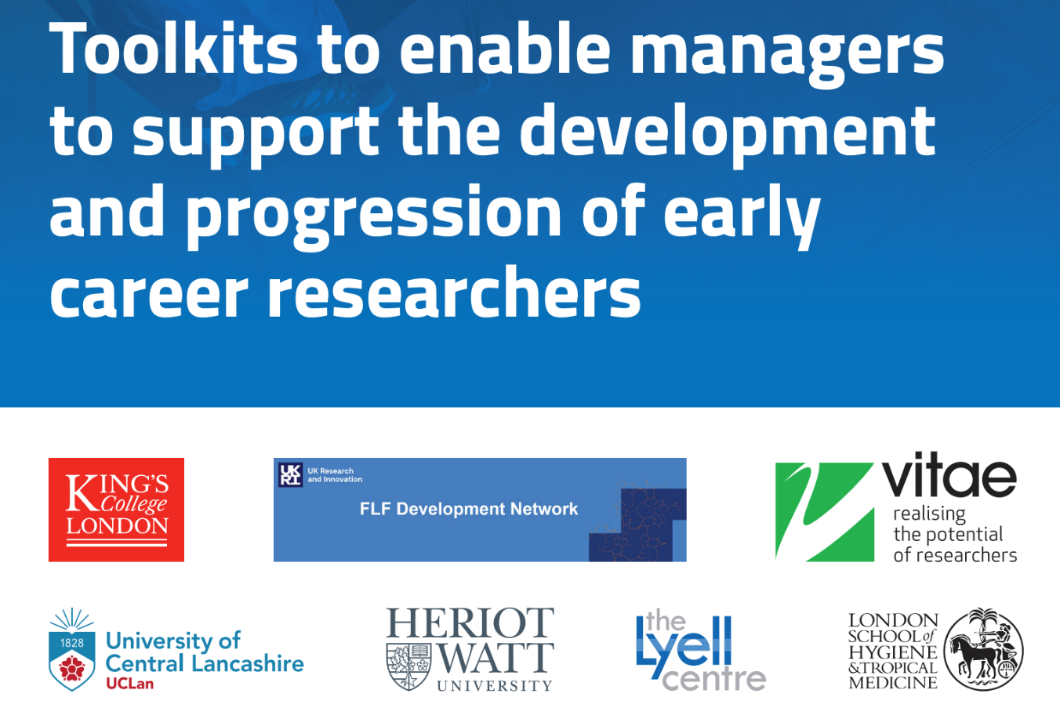
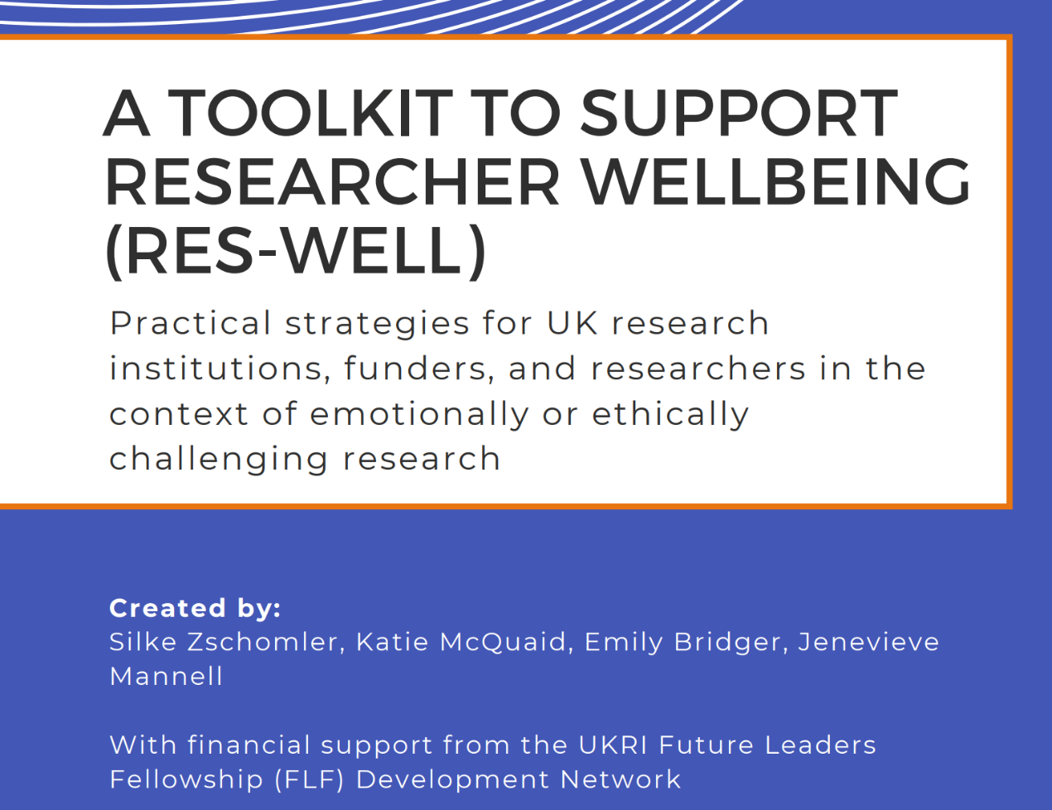
Toolkits: FLF led

Slide 14
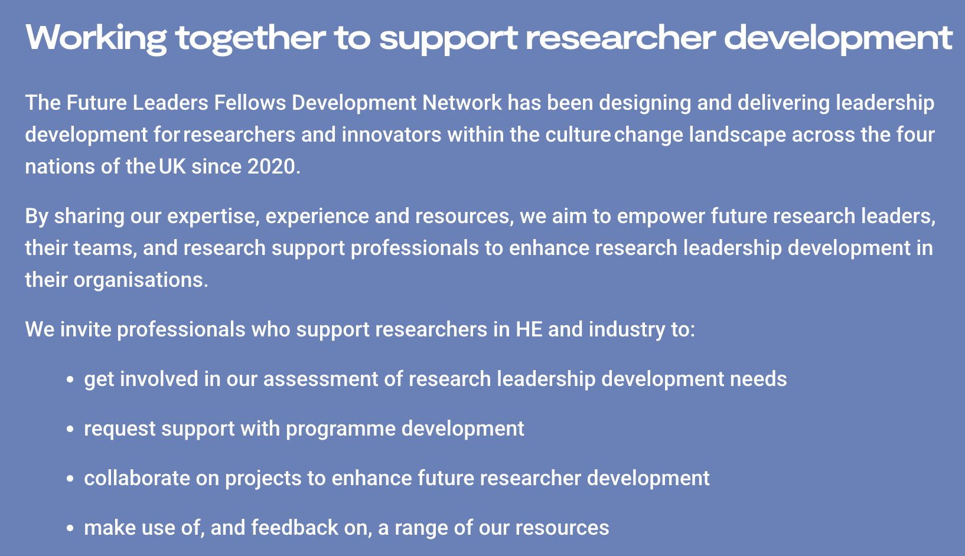
FLFDN: enabling future research leaders
Contact us: hello@flfdevnet.com

Slide 15

k.nicollbaines@ed.ac.uk

